Slide 1
Green public procurement in the Czech Republic
Michaela Valentová
SEVEn, The Energy Efficiency Center
BuySmart+, 31st May 2012 Budapest

Slide 2
About SEVEn
Non-profit consultancy founded in 1990
Mission of SEVEn: environmental protection and support of economic development through more efficient use of energy
Main activities:
  Consultancy in energy efficiency and renewable energy sources (energy policies, strategic documents, audits and feasibility studies)
  Development of EPC (Energy Performance Contracting) in CZ
  Cooperation with municipalities, state and public organizations as well as business

Slide 3
Introduction
  Green Public Procurement represents about 20 % of Czech GDP
      30 billion EUR per year
  “In the 42 contracts belonging to the sample, Czech authorities used some form of green criteria in 29% of the cases, almost half the EU average.” (CEPS 2012 )
    None included all core GPP criteria

Slide 4
Legislative framework
Act No. 137/2006 on public tenders
  Implementing environmental provisions of the directives 2004/18/EC and 2004/17/EC
  Giving the possibility to include environmental criteria in GPP
  To evaluate the offers according to lowest price or “the most economically advantageous offer” in which more criteria can be introduced

Slide 5
Legislative framework
Govt. Decision No. 465/2010 on the Guidelines for environmental criteria in public tenders
  Provides the Guidelines for purchases of the government and municipalities
  Methods of purchases of furniture and IT equipment
  Members of the government and government organizations have to follow these criteria
  Other governmental and public organizations are recommended to follow them
Criteria for other products to follow

Slide 6
Criteria for IT equipment and furniture
Methods are very detailed including guideline on organizing and evaluating the tender with examples of the green tenders
IT equipment
PC, notebooks, monitors, printers, copiers, ...
Common: RoHS and declaration of conformity (CE),Energy Star requirements, easy disassembly
PC – memory accessible, mercury content in background lighting, sound power level, Printers – double sided printing
Furniture
Standard (obligatory) requirements: Hazardous content, surface treatment, recyclability and use of recycled materials
Additional (voluntary) requirements: textiles and filling (ecolabel), polyur. foam (HFC, methylenchloride), stricter requirements for surface treatment and packaging
To large extent follows criteria of EU EcoLabel and Environmentally Friendly product
Website: www.zelenenakupovani.cz
Notes:
Hydrofluorohydrocarbons
2002/95/ES Restriction of the use of certain Hazardous Substances

Slide 7
How are the criteria used?
Ministry of the Environment
Tender for IT equipment through e-market
Public tender in 2010
Apart from the purchase of new IT equipment (mostly computers), the purpose was to confirm the methods approved by Government
The use of criteria is not totally clear.
Monitoring has been established by the MoE.
  However, not publicly available

Slide 8


Ecolabels
  Environmentally friendly product/service
  Since 1994
  Managed by the Agency for environmentally friendly products and services as part of Czech Environmental Information Agency (CENIA)
  Belongs to the type I labels
  Registration fee:
    400 - 800 EUR (200 – 400 EUR for service),
    No yearly fee (for services 100 – 200 EUR)
  Ecolabels given only to a specific model
  Currently 64 product groups
    Furniture, gas boilers, tourism, detergents
    Not in all specific products
  Currently over 200 specific products and services
    Gas boilers, furniture, cleaning products
Notes:
Národní program označování ekologicky šetrných výrobků a služeb se řídí ustanoveními technické normy ČSN ISO 14024 Environmentální značky a prohlášení - Environmentální značení typu I. Ekoznačka Ekologicky šetrný výrobek/služba je proto uznávaným dokladem o kvalitách výrobků a služeb i v zahraničí, ačkoli se vztahuje jen na produkty nabízené na trhu České republiky.

Slide 9
Other instruments and sources for GPP
Many activities “bottom-up”
BuySmart+
    Promotion of Green (Public) procurement
Come On Labels
  Promotion of energy labels and their proper implementation
Covenant of Mayors
  Covenant of Mayors covering cities that committed to decreasing their CO2 emissions by more than 20 % by 2020 – in total more than 3700 in total
  3 cities in the Czech Republic

Slide 10
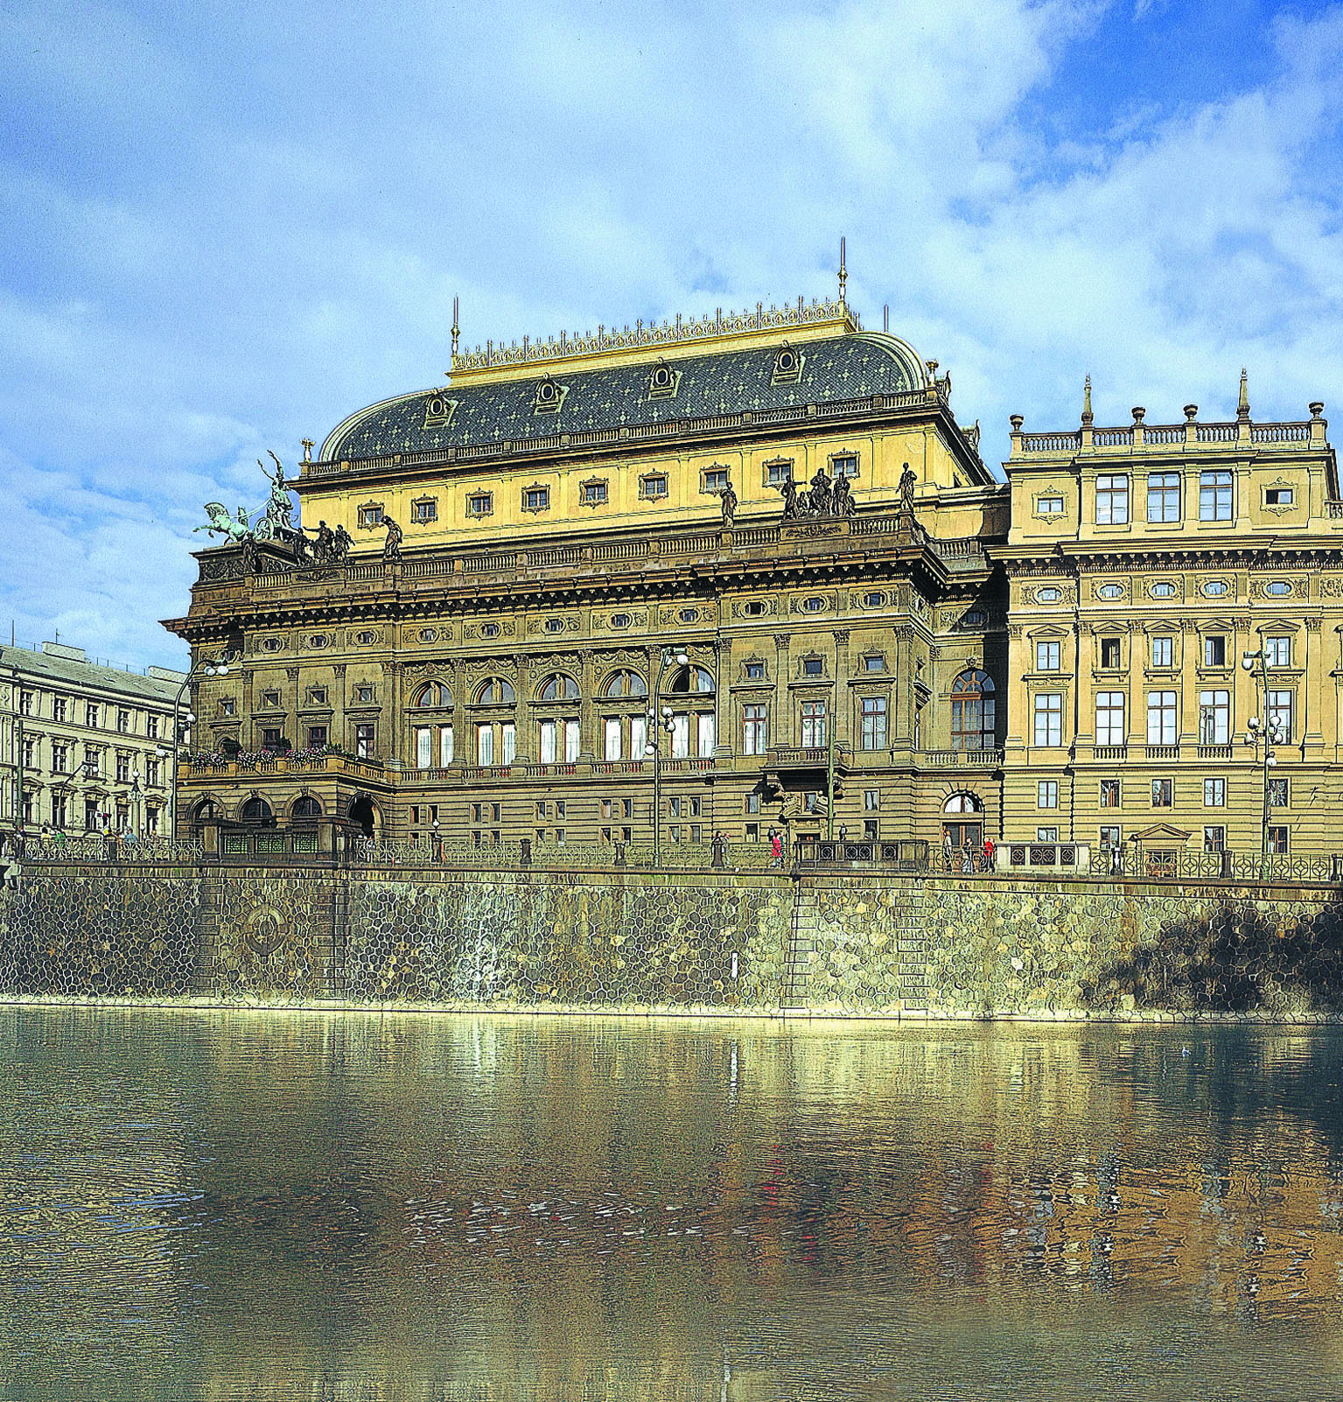
Good practice examples (I)
National Theatre - Lighting
Set of 4 buildings, 1 historical (1873)
Most important measures:
Replacement of classic light bulbs with CFLs and halogen lamps (where 100% dimming needed)
Emergency lighting – from 15W classic to 2 W LEDs
Parking place – lowering voltage by 20 %

Slide 11
Good practice examples (I)
National Theatre
Part of EPC project realised in 2009
The ESCO guarantees savings of electricity in total approx. 500 MWh/year (i.e. over 40 000 EUR/year)
Further savings generated thanks to removing the need to purchase and replace the original light bulbs that often (of additional 36 000 EUR/year)
Very good economics of the measures in lighting allowed realising further measures (e.g. second set of PV panels on rooftop of the New Scene), which would otherwise go beyond the contract duration of EPC

Slide 12
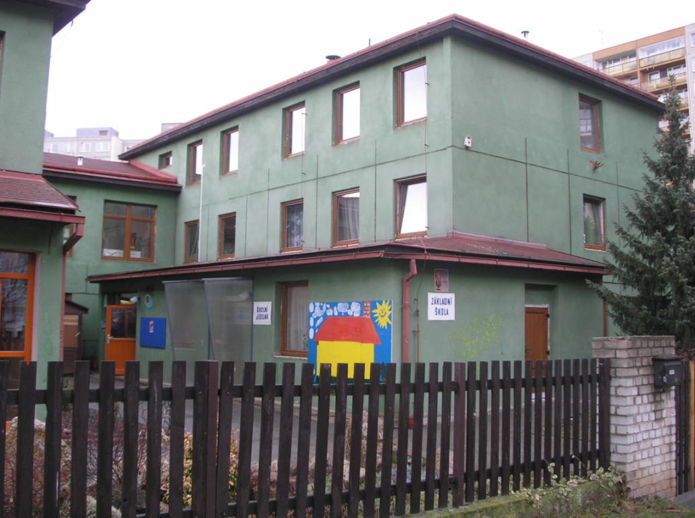
Good practice examples (II)
15 schools in Prague 13
Reconstruction of technology equipment through EPC (new condensation boilers and regulation and measurement system):
Investment of 3.2 million EUR
Financed from future energy cost savings
Building insulation and windows replaced:
Investment of 12 million CZK
Co-financed through subsidy
Own sources of less than 28 %

Slide 13
Good practice examples (II)
15 schools in Prague 13
Public tender „EPC in selected objects of Prague 13“
From four ESCOs the winning company was selected on the basis of the following criteria:
Guaranteed savings in all forms of energy in technical units for 10 years after putting the installed technologies in operation after their reconstruction. Compared to reference year 2008 weight 55 %
Price, which is understood as the total price that the tendered will pay to the selected company over 10 years weight 30%
Quality of the technical design (i.e. relation between the technical solution and savings), offered additional services weight 15%

Slide 14
THANK YOU FOR YOUR ATTENTION
Michaela Valentová
SEVEn, The Energy Efficiency Center
michaela.valentova@svn.cz
www.svn.cz, www.buy-smart.info

