Slide 1

National workshop
31 May 2012, Budapest
Regina Aufreiter
O.Ö. Energiesparverband
Landstr. 45, A-4020 Linz, Austria
T: +43-732-7720-14869 regina.aufreiter@esv.or.at www.esv.or.at

Slide 2
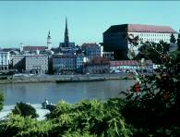
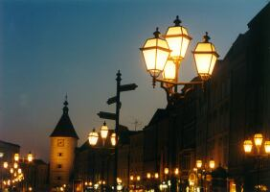
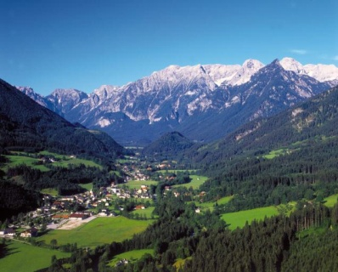
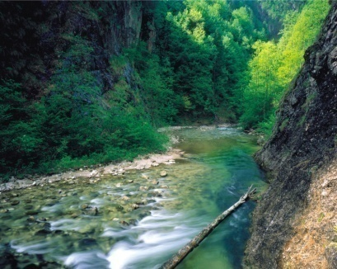
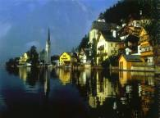

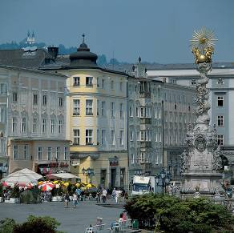
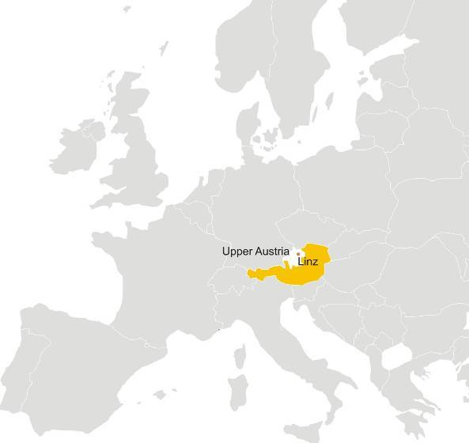
The Region of Upper Austria - Oberösterreich
Capital: Linz
Population: 1.38 million
Area: 12,000 km²
Gross inland cons.: 293 PJ; 34 % renewables
Economic activities: industry, service sector,
tourism, 25% of the Austrian
industrial exports

Slide 3
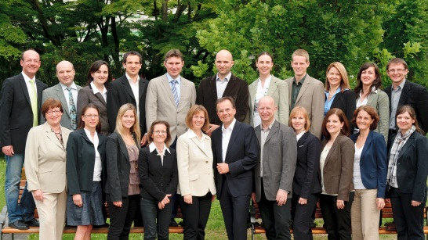
O.Ö. Energiesparverband
Energy Agency of the Region of Upper Austria
Organisation
founded (in 1991) and mostly funded by the regional government
promotes energy
efficiency and
renewable energy
provides services
to private households,
public bodies &
businesses
manages programmes on behalf of the state government
supports development of legislation and policies
Services
Energy advice (15,000 sessions/a)
Energy certification of buildings
Energy Academy: Training programmes
Management of funding programmes
Public awareness campaigns, events, publications
Pilot projects
Municipal energy strategies
European cooperation
OEC network

Slide 4

Oekoenergie-Cluster Upper Austria
(OEC)
network of renewable energy & energy efficiency companies
160 partner companies
since 2000, managed by the O.Ö. Energiesparverband
main business fields
  - biomass heating
  - solar heating
  - energy efficient buildings
Main fields of activities:
information
training
cooperation
R&D
export activities
marketing and PR
www.oec-en.at
turnover: 1.8 billion Euro
employees: ~ 7,300
export share: > 50 %
Notes:
4
4
4

Slide 5

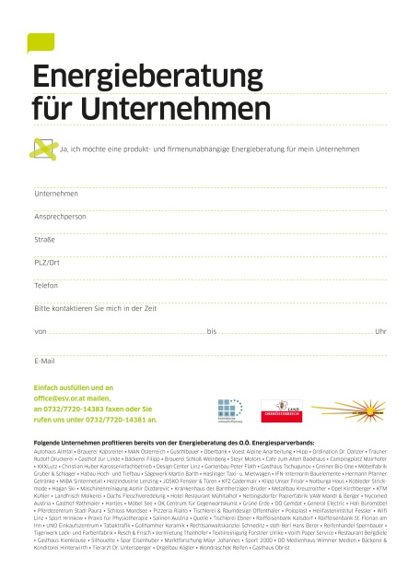
Energy Advice Service for Companies
Target group:
all companies located in Upper Austria
Content:
basis advice session (2 days)
detailed advice session (on demand)
Content:
reduction of energy costs
innovative RES & EE technologies
energy support programmes
process optimisation
new construction/retrofitting of company building
> 2,500 advice sessions in Upper Austrian companies held!
75% of the costs are subsidised

Slide 6
Energy Action Plan of Upper Austria
1994 - 1999
30 % renewable energy
(hydro, wood biomass, solar)
energy consumption in
new housing reduced by 30 %
15,000 jobs
2000 - 2010
double biomass & solar
1 % energy saving/year
1.5 % energy savings in
the public sector/year
2010-2030
100 % space heating & electricity from renewable energy
reduction of heat demand by 39 %
minus 65 % CO₂ emissions

Slide 7
Upper Austria‘s sustainable energy strategy - 3 Pillars
Regulatory
measures
Financial
measures
Information
activities
"sticks"
"carrots"
"tambourines"

Slide 8
Legal framework for procurement
European level:
- Ecodesign Directive,
- Directive 2006/32/EG on energy end-use efficiency
- Communication "Public procurement for a better environment"
(KOM(2008) 400)
National level:
- "Bundesvergabegesetz" (BVergG 2006) – National law on tendering
- National Energy Efficiency Action Plan of Austria (NEEAP, June 2011)
Regional level:
- "Vereinbarung zwischen Bund und Ländern gemäß Art.15a B-VG zur
Umsetzung der Richtlinie 2006/32/EG über Endenergieeffizienz" - an
agreement between national and regional governments (19 Feb. 2011)

Slide 9
Example: Austrian NEEAP

Slide 10
Procurement – the role of
the regional level (1)
Procurement for regional administration departments and authorities, on district level in Upper Austria (district authorities) is mainly done by the department for Procurement of regional administration (ZeB).
This organisation was established in summer 2006 with the objective to ensure efficient procurement.
5 different procurement groups were established:
IT, office supplies (paper etc.), office equipment and electrical devices, fuel and maintenance.

Slide 11
Procurement – the role of
the regional level (2)
Concrete implementation measures of the agreement ("15a Vereinbarung") on regional level include among others:
Ecological guide ("Ökoleitfaden") of the central procurement organisation (ZeB) including energy efficiency criteria for different product groups
Implementation of the EU projects, e.g. "Pro-EE" of the regional government of Upper Austria
Energy Contracting: Support programme of the regional government of Upper Austria.
"Demand allocation mechanism" of the regional government ("BZ-Mittel") for public buildings linked to energy efficiency criteria

Slide 12
Procurement – Measures
in the private sector
Efficiency requirements for:
- the construction and the renovation of commercial buildings
- the heat demand of new buildings
- the heat demand of renovations
- the cooling demand
- building components for new building and renovations
Efficiency criteria for the allocation of subsidies
(e.g. Bundes-/Landesumweltförderung)
Energy Contracting Programme of Upper Austria

Slide 13
How to trigger market development for energy efficient procurement
Key elements for triggering energy efficient procurement:
Continuous information and promotion…..
Advice, advice, advice…..
Training seminars on specific topics
Financial support programmes, e.g.
  "EGEM" – Energiespargemeinden"
  Energy Contracting Programme

Slide 14
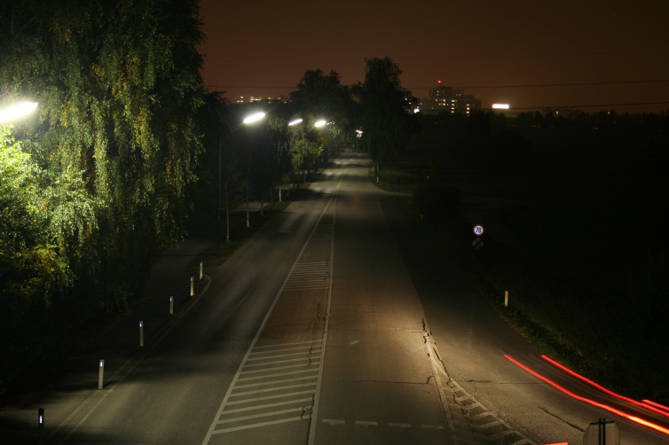
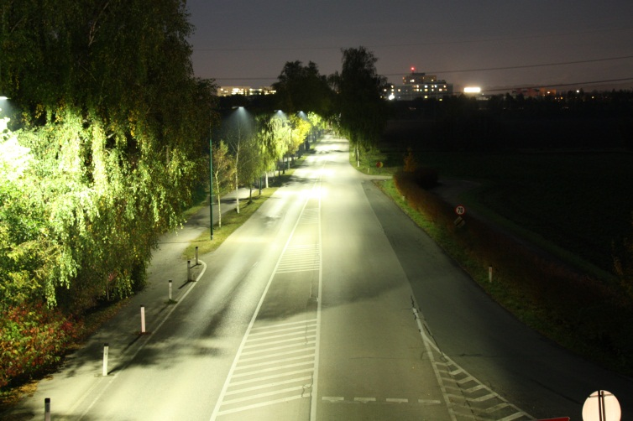
Examples: Energy efficient procurement in Upper Austria
City of Wels – new street lighting as contracting project
lamps/luminaires older than 15 years
target: reduction of energy consumption,
improvement of illumination
support during procurement process
retrofit of around 50% of public street
lighting
4,200 light spots exchanged by LED
technology
realisation within 1,5 year
annual cost savings: 200,000 Euro,
annual CO₂ savings: 557 tons

Slide 15
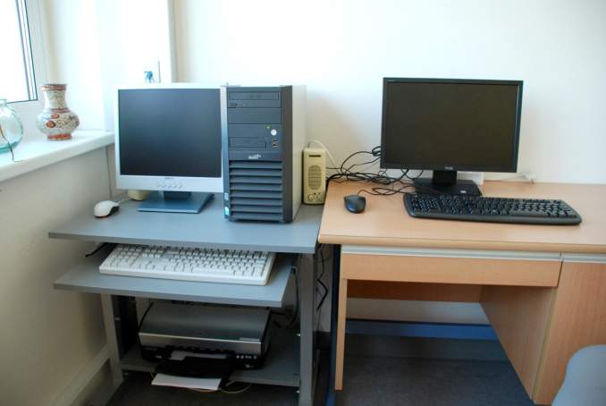
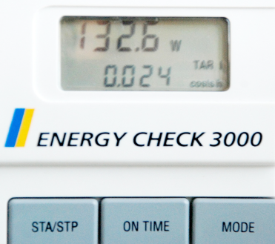
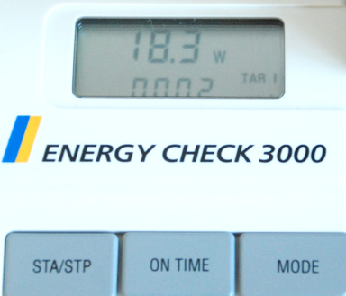
Examples: Energy efficient procurement in Upper Austria
Municipality of Thalheim
  replacement of inefficient IT equipment of primary school
  target: meet the needs of modern IT working place, improve energy efficiency
  15 new equipped IT working places installed
  realisation within 3 months
  annual cost savings: 200 Euro
  annual CO2 savings: 0.6 tons
„old“ equipment
„new“ equipment

Slide 16
Main challenges
main barriers are lack of information and know-how on possible savings
very often life cycle costs are not paid attention
lower purchasing activities due to economic crisis and strict saving plans in public budgets
initiating pilot projects is very challenging
documentation of results is difficult
difficult to find the right contact person who is responsible
develop and establish support tools that are really needed

Slide 17
Conclusions & recommendations
The time for green procurement including energy efficiency criteria in purchasing decisions is ideal. European, national and regional policies draw the focus on energy efficiency which is key to achieve CO2 reduction targets in the future.
After receiving information, purchasers are willing to pay attention to Buy Smart criteria.
Support tools are very important, e.g.
  Financial support
  Information tools
  Face to face advice
Making green procurement part of the company business plan…

Slide 18
Thank you
for your attention
Regina Aufreiter
O.Ö. Energiesparverband
Landstr. 45, A-4020 Linz, Austria
T: +43-732-7720-14869
regina.aufreiter@esv.or.at
www.esv.or.at

Slide 19
Upper Austria's sustainable energy strategy –
example sustainable buildings
"sticks"
"carrots"
"tambourines"
Regulatory measures
Financial measures
Information & training
Energy performance requirements &
building certification
Minimum requirements heating & cooling
Inspection of boilers & & AC systems
Renewable heating
obligations (public
buildings)
Soft loans for efficient
construction & renovation
Grants for renewable heating & efficiency measures
Pilot projects, regional R&D programme
Contracting progr.
Energy advice
Training & education programs
Publications, campaigns & competitions
Local energy action plans
Sustainable energy business network
stimulate demand
Policy Packages
support supply
Notes:
19

Slide 20
Typical approach for market development projects
Example: energy efficient procurement
Identifying needs
Surveys
Publications - Information
Seminars / Events
Implementa-tion of ee procurement
Communica-tion with stakeholders
Market research
(by ESV -team or externally)
Info-folder
Information seminars
Advice
(face-to face)
Technical guidelines
Training courses
Promotion of best practice
Round table - meetings
Performance sheets
European project studies
Conferences
Advice
(face-to face)
PR / Press
Workshops
European exchange
… for specific target groups

Slide 21


World Sustainable Energy Days 2013
27 February – 1 March 2013
Wels / Austria
- Conference Nearly Zero Energy Buildings
- European Pellet Conference 2013
- WSED next! for young researchers
- Energy Efficiency Watch Conference
- Trade Show - Energiesparmesse
Call for Papers: 8 October 2012
www.wsed.at

